Slide 1
ASP.NET MVC CORE
Instructor: Edwin oduor

Slide 2

Quote of the day

Slide 3
Lesson objectives
Authorize

Slide 4
Lesson pre-requisites
In order to take full advantage of this section you need to have the following;
Computer with Visual Studio Installed.
Stable Network Connection.

Slide 5
Training methods and extra readings
TRAINING METHODS FOR THIS LESSON
EXTRA READINGS
Lecturing Method – This is the main method of training to be adopted in this lesson with illustrations and practical coding examples.
Discussion Method - This method will be adopted periodically whereby learning will be derived principally from the students brainstorming together, rather than from the trainer. Three main types of discussions will be used:
Directed discussion
Developmental discussion
Problem-Solving discussion
Home and Learn C#

Slide 6
authorize

Slide 7
If we want to prevent a user from performing some actions in the application then we can use authorize on the action that we want to prevent a user from doing.
For instance the way our application is at the moment one can access all the pages even if they are not logged into the system, what we want to do id to prevent any user who hasn’t logged in to access any of the pages, they have to be logged in to access the pages in the system or application.
To do this then will use authorize on the method that we want to prevent a user who hasn’t logged in to perform any actions.

Slide 8
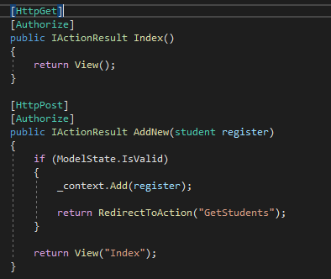
Authorize method is being used in the index method and the AddNew method.

Slide 9
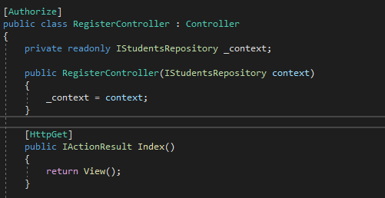
On the other hand if a controller has many methods and you want to use authorize in all this methods all at once then Authorize will be added at the controller level when this is done then all the methods in the controller will be affected.

Slide 10
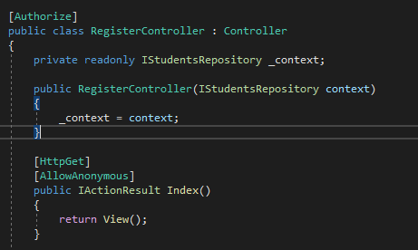
Suppose there is a method in the controller that you don’t want to apply the authorize method to then for that method then you will use AllowAnonymous.

Slide 11
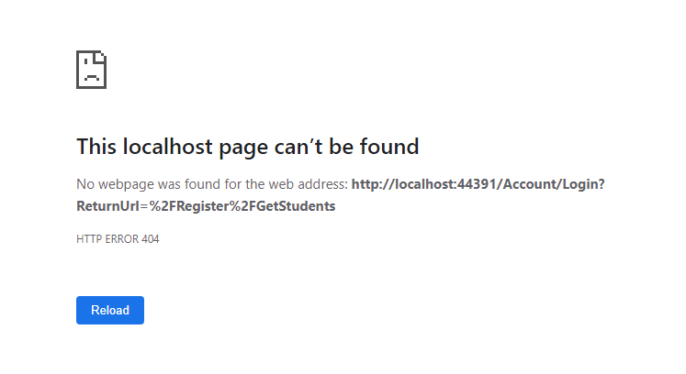
When using the authorize method the system will direct the user to the login page that is because for one to access the requested Action they should be logged in, in our case this is what we get.

Slide 12

To fix the issue in the previous slide then we need to write the following code in that startup.cs file.
Accounts is the name of the controller and Login is the Action in the controller.

Slide 13
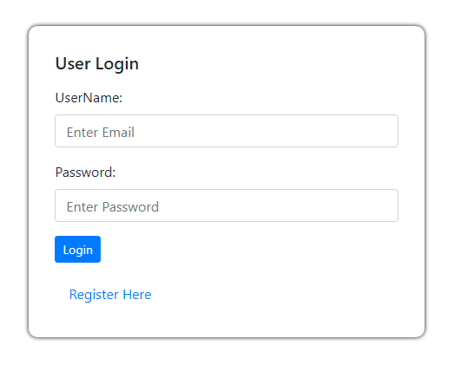
When a user tries to access a page and they are not logged in then the application will redirect them on the login page.

